Slide 1
Recap

Slide 2
Windows Apps
Mike Irving

Slide 3
Windows Apps
.NET 7 for all apps
Modernising Apps
The Windows Apps SDK
.NET Upgrade Assistant
Blazor Hybrid Apps
WinUI 3
Uno Platform
Avalonia UI

Slide 4

Every app can upgrade to the latest .NET
WinForms, WPF | ⟶ | upgrade to .NET 7 with https://aka.ms/dotnet/upgrade
UWP | ⟶ | upgrade to WinUI 3
Xamarin.Forms | ⟶ | upgrade to .NET MAUI
WCF | ⟶ | upgrade to .NET 7 Core with WCF
ASP.NET | ⟶ | upgrade to ASP.NET Core
libraries | ⟶ | if used from both .NET Framework and .NET, keep on .NET Standard 2.0; if only .NET, upgrade to .NET 7

Slide 5

The Windows App SDK
The Windows App SDK provides a unified set of APIs and tools that can be used to create production desktop apps that target Windows 10 and later, and can be published to the Microsoft Store.
The Windows App SDK doesn't replace the Windows SDK or existing desktop Windows app types such as .NET (including Windows Forms and WPF) and desktop Win32 with C++.
Instead, the Windows App SDK complements these existing tools and app types with a common set of APIs that developers can rely on across these platforms.
Microsoft Learn - https://learn.microsoft.com/en-us/windows/apps/windows-app-sdk/
GitHub - https://github.com/microsoft/WindowsAppSDK

Slide 6
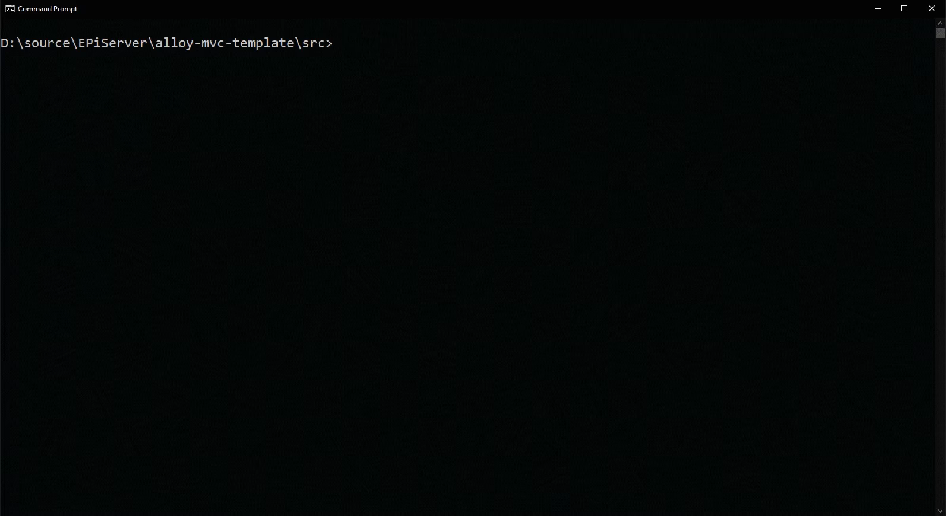
.NET Upgrade Assistant
Download https://aka.ms/dotnet/upgrade
.NET Framework Windows Forms apps
.NET Framework WPF apps
.NET Framework server-side WCF apps
.NET Native UWP apps
.NET Framework ASP.NET MVC apps
.NET Framework console apps
.NET Framework class libraries

Slide 7


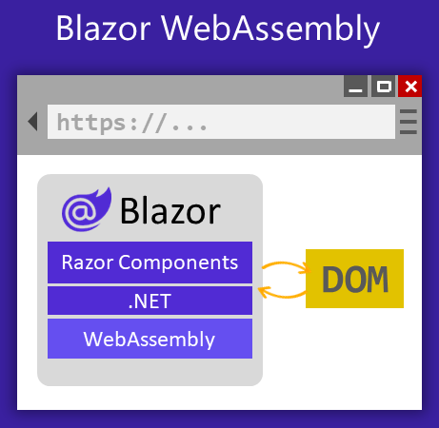
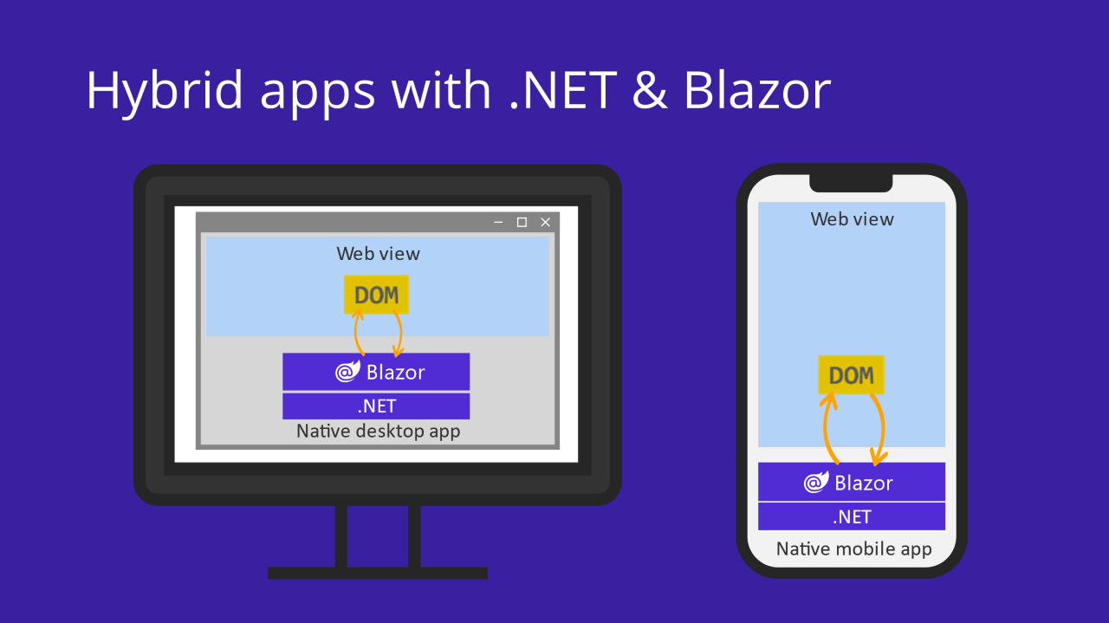
Blazor Hybrid apps

Slide 8
Blazor Hybrid apps
Getting Started:
Add BlazorWebView NuGet Package
Benefits:
Modernising Apps, Shared State
Sharing Code and Components with Razor Class Libraries
Navigation: Blazor App tapping into Native Navigation

Slide 9
Blazor Hybrid apps
Blazor Hybrid apps with .NET MAUI
Blazor Hybrid support is built into the .NET Multi-platform App UI (.NET MAUI) framework. .NET MAUI includes the BlazorWebView control that permits rendering Razor components into an embedded Web View. By using .NET MAUI and Blazor together, you can reuse one set of web UI components across mobile, desktop, and web.
Blazor Hybrid apps with WPF and Windows Forms
Blazor Hybrid apps can be built with Windows Presentation Foundation (WPF) and Windows Forms. Blazor provides BlazorWebView controls for both of these frameworks. Razor components run natively in the Windows desktop and render to an embedded Web View. Using Blazor in WPF and Windows Forms enables you to add new UI to your existing Windows desktop apps that can be reused across platforms with .NET MAUI or on the web.

Slide 10
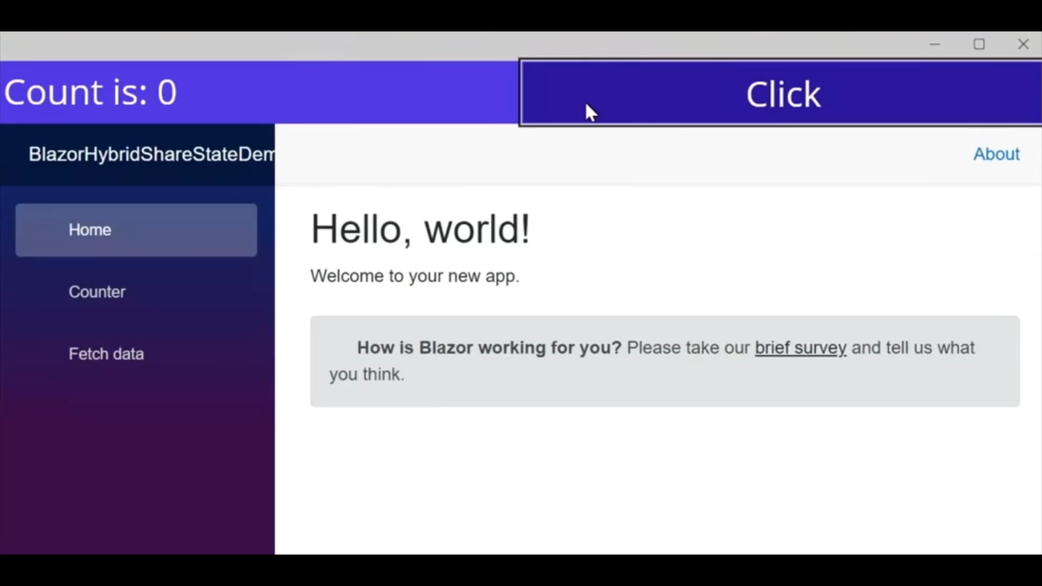
Blazor Hybrid apps with .NET MAUI

Slide 11
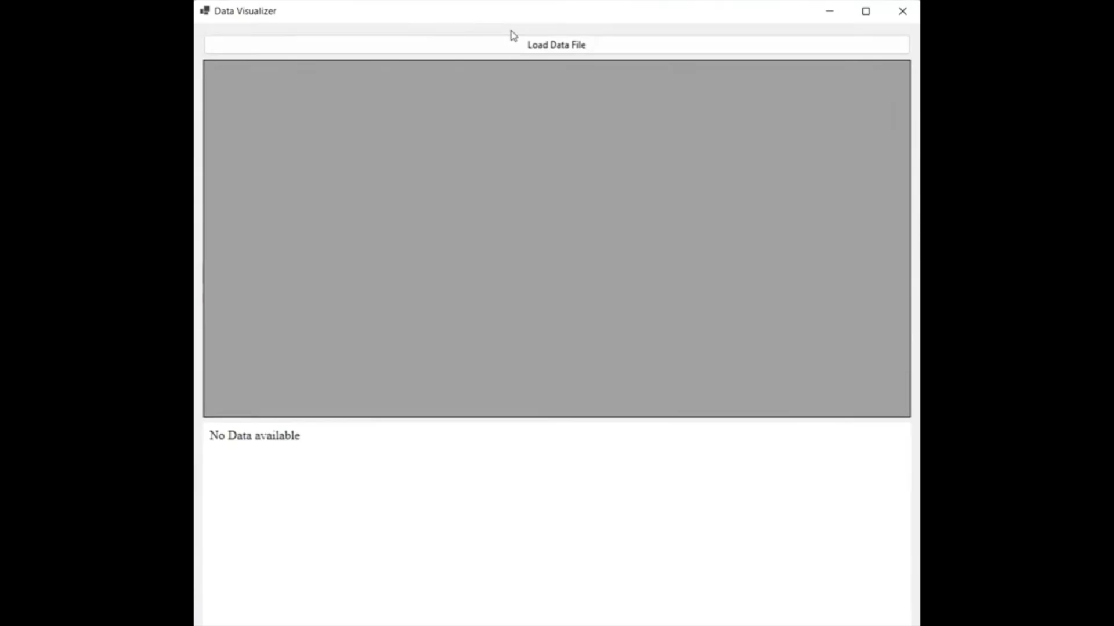
Blazor Hybrid apps with WinForms

Slide 12
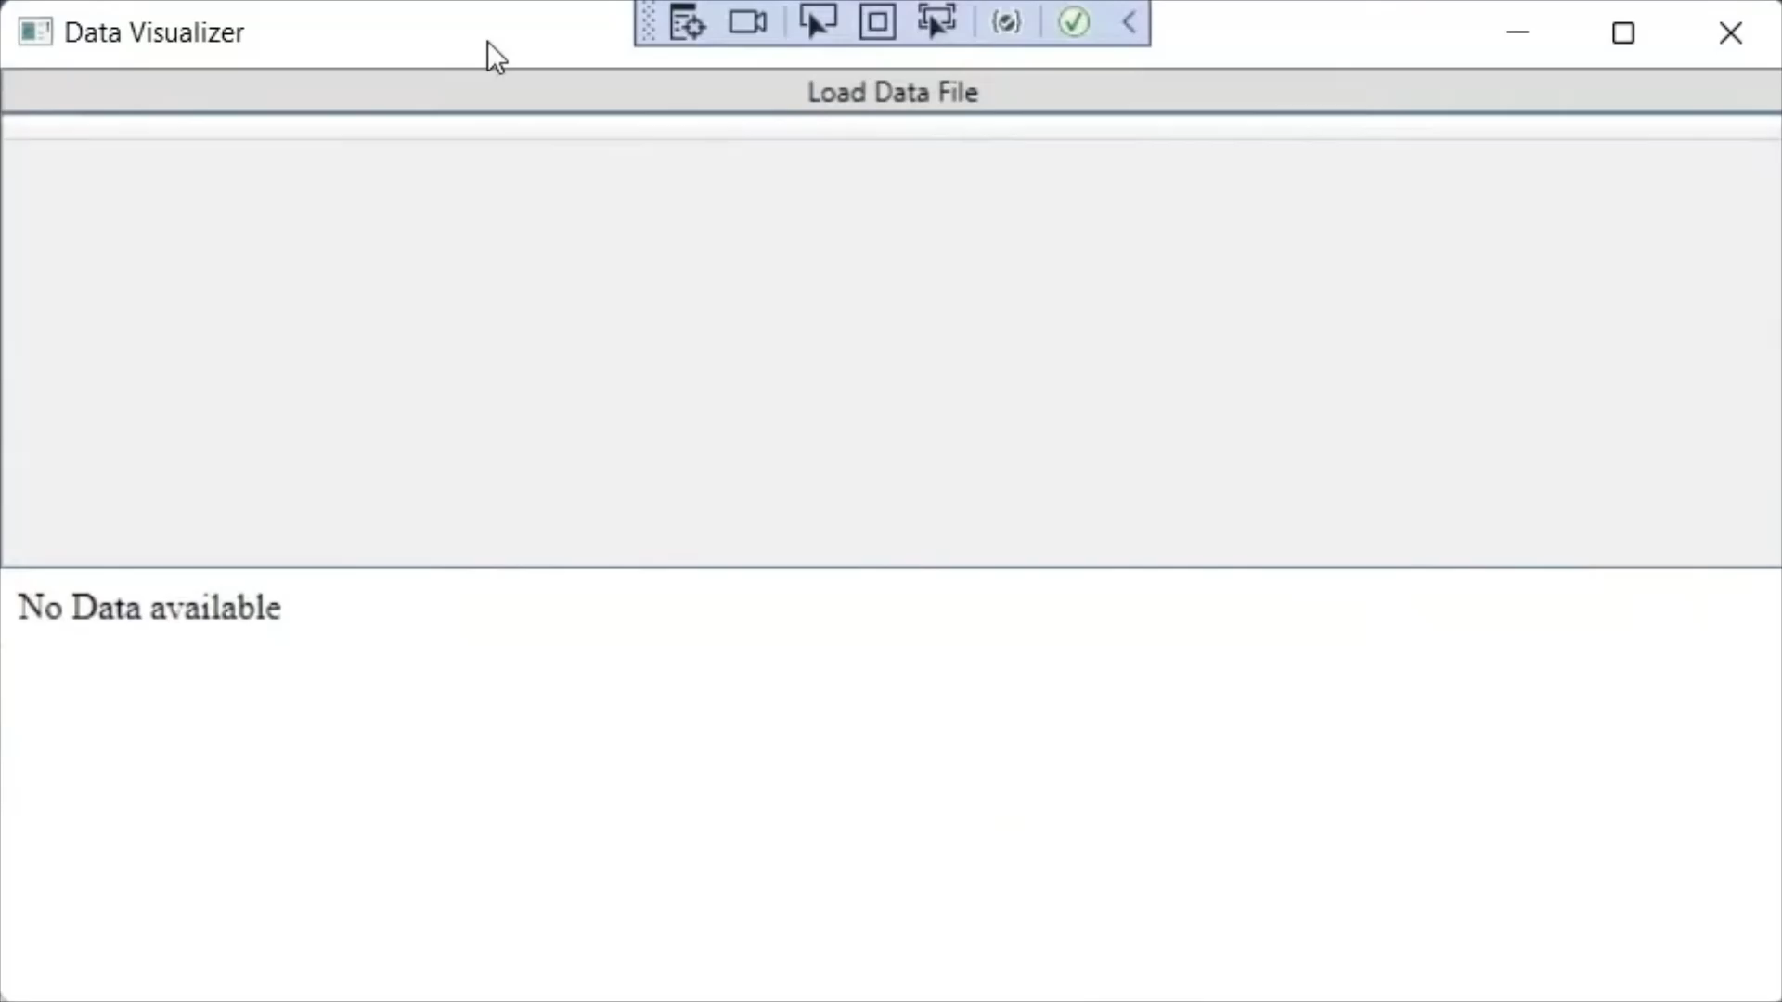
Blazor Hybrid apps with WPF

Slide 13
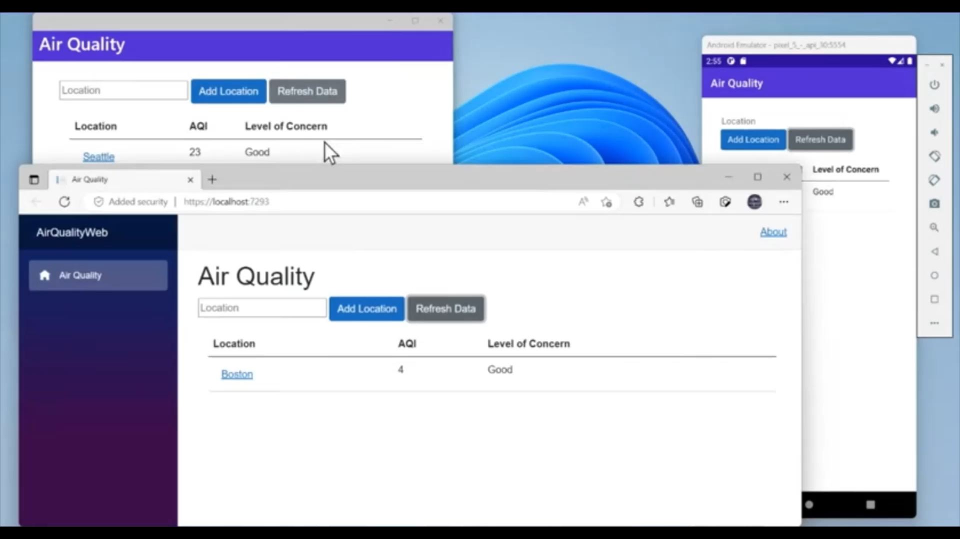
Blazor Hybrid apps - Effective Navigation

Slide 14
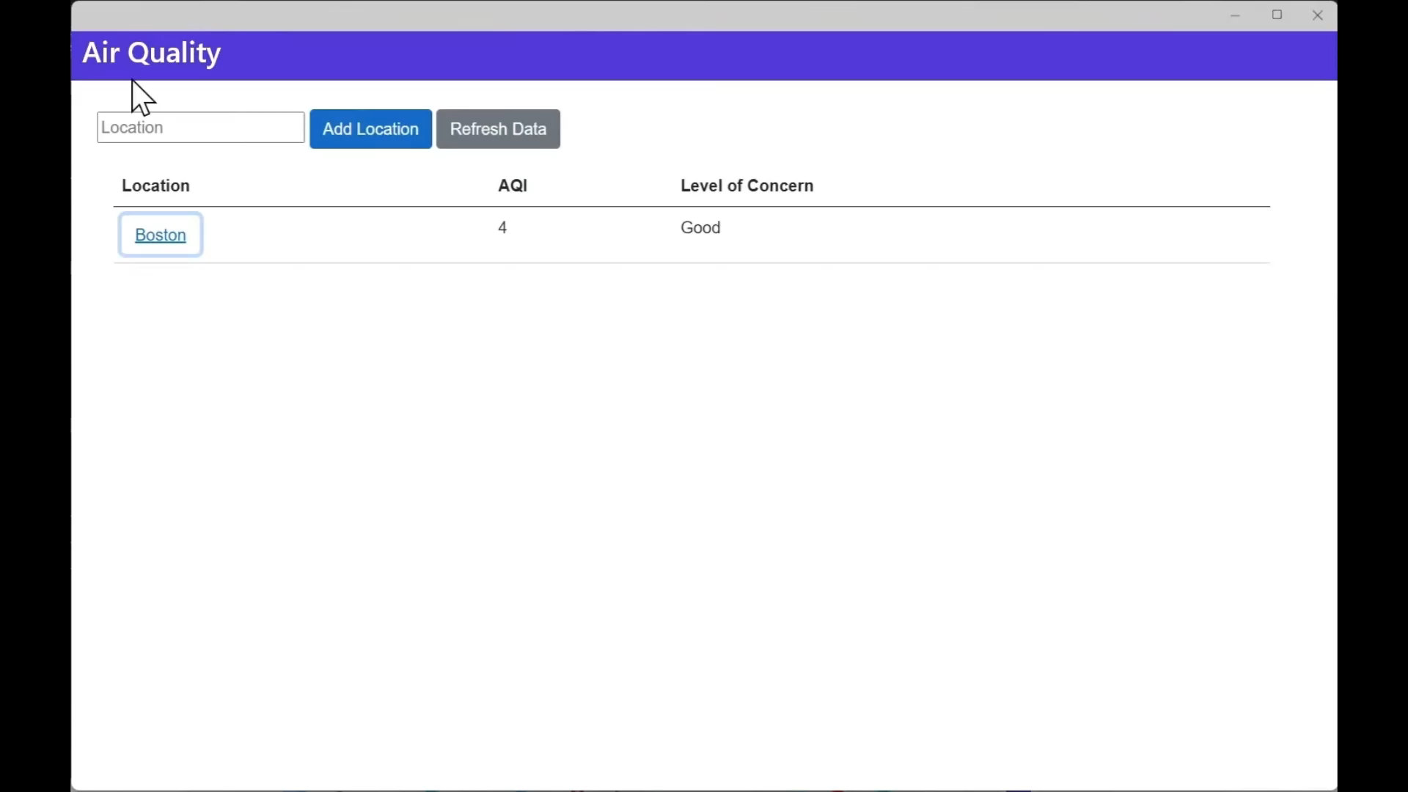
Blazor Hybrid apps - Effective Navigation

Slide 15
Blazor Hybrid apps
Microsoft Learn – https://learn.microsoft.com/en-us/aspnet/core/blazor/hybrid/
Blazor website - https://dotnet.microsoft.com/en-us/apps/aspnet/web-apps/blazor
GitHub - https://github.com/dotnet/aspnetcore
Video from .NET Conf: Create native desktop & mobile apps using web skills in Blazor Hybrid Eilon Lipton & James Montemagno https://youtube.com/watch?v=ojcvL8KCOwo

Slide 16

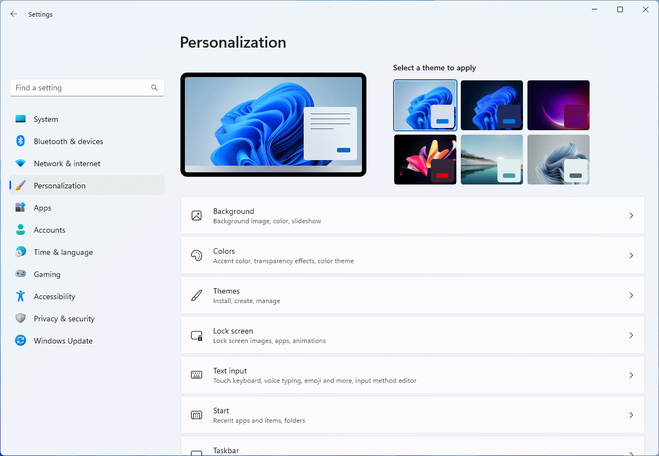
WinUI 3
WinUI 3 is the native UI platform component that ships with the Windows App SDK (completely decoupled from Windows SDKs).
Fluent Design System
Upgrade path for UWP
Go cross platform with Uno Platform

Slide 17
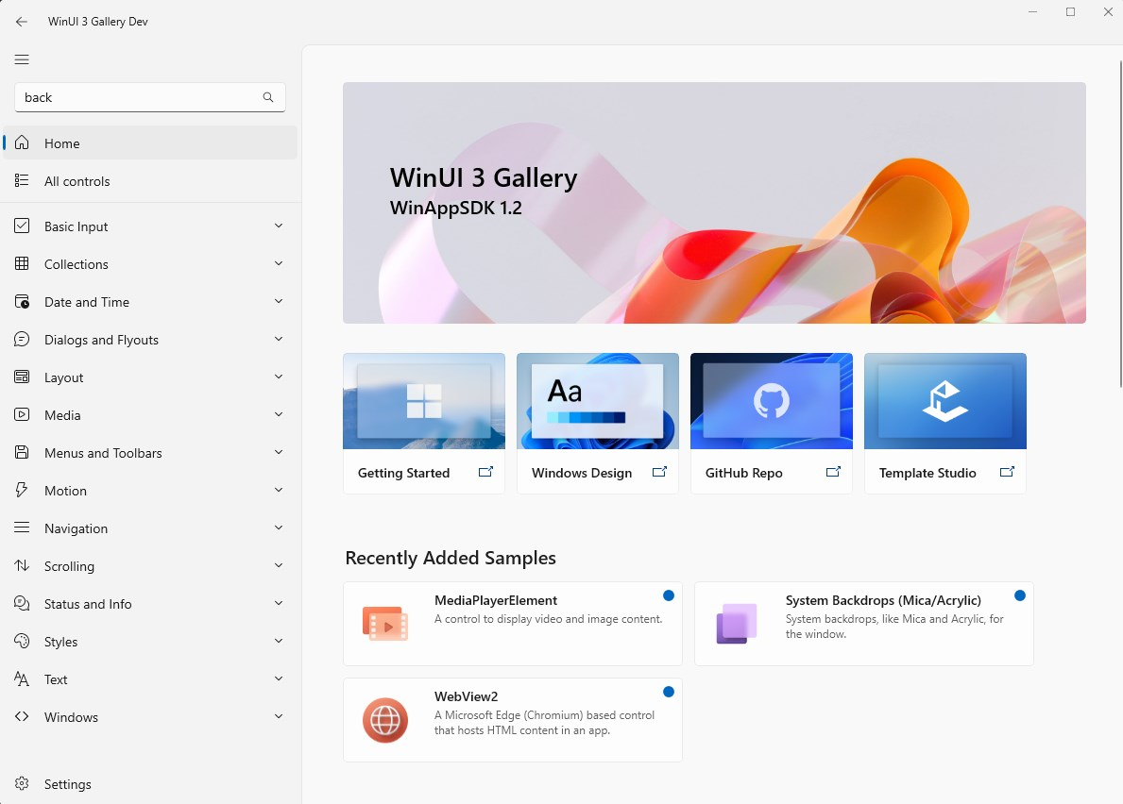
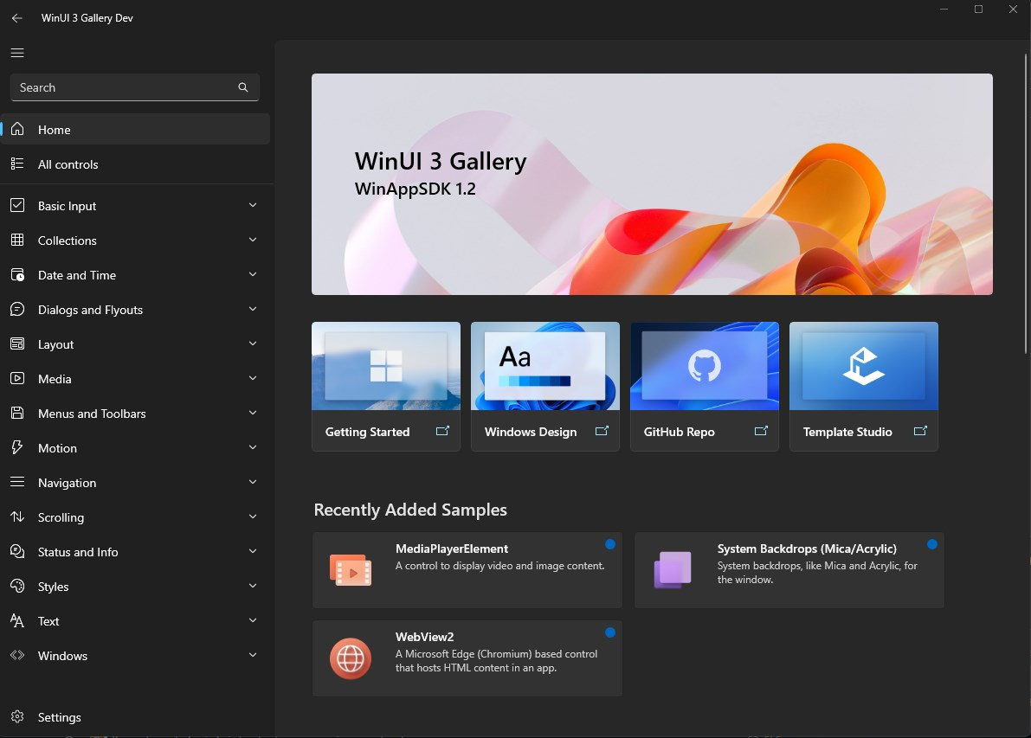
WinUI 3
WinUI 3 Gallery – Windows Store App

Slide 18
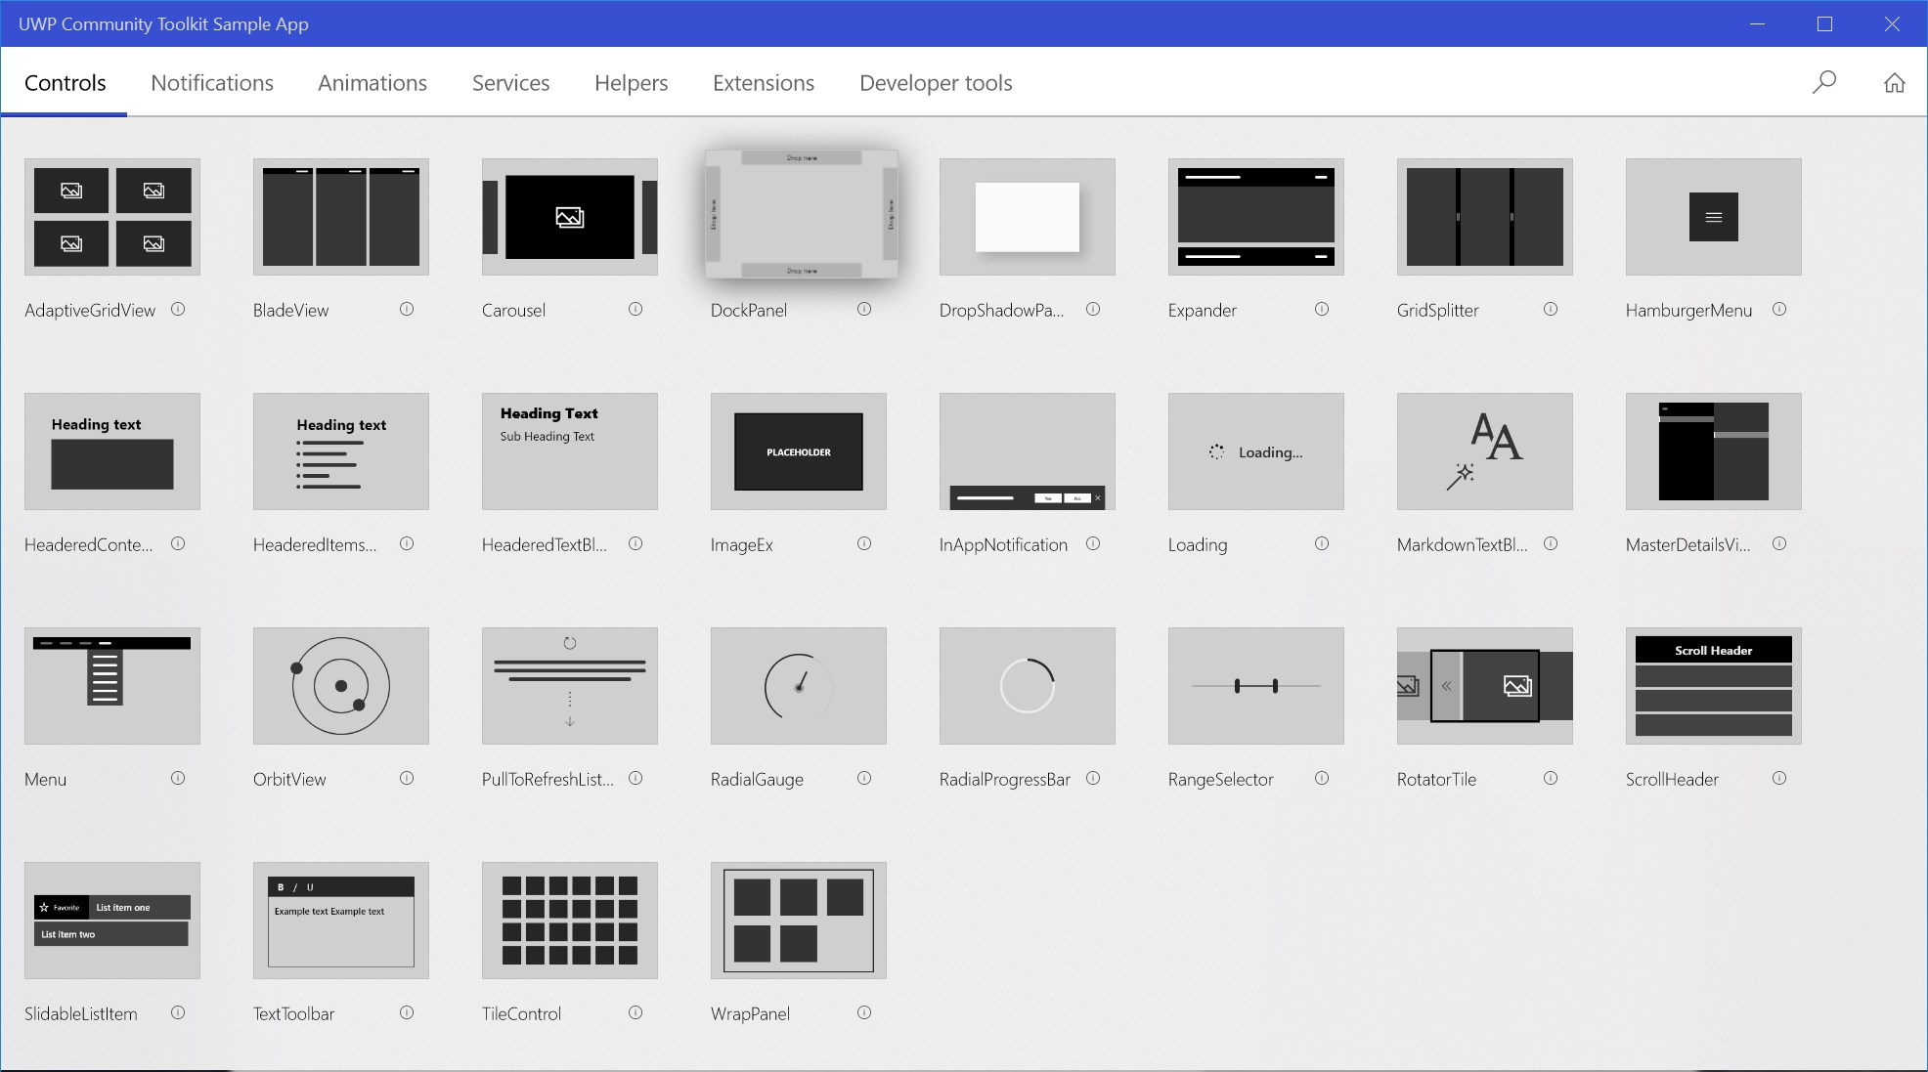
WinUI 3
Windows Community Toolkit
The Windows Community Toolkit is a collection of helpers, extensions, and custom controls. It simplifies and demonstrates common .NET developer tasks building UWP and WinUI 3 apps for Windows 10 and Windows 11. The toolkit is part of the .NET Foundation and available on GitHub at https://aka.ms/windowstoolkit
Windows Community Toolkit Sample App – Windows Store App

Slide 19
WinUI 3
Microsoft Learn - https://learn.microsoft.com/en-us/windows/apps/winui/winui3/
WinUI 3 Gallery - https://apps.microsoft.com/store/detail/winui-3-gallery/9P3JFPWWDZRC
Windows Community Toolkit - https://aka.ms/toolkit/windows
GitHub - https://github.com/microsoft/microsoft-ui-xaml
Videos from .NET Conf: Building Windows apps with WinUI 3 and .NET – Nick Randolph https://youtube.com/watch?v=sYBCFTRmHOA Accelerate your WinUI 3 app with the Windows Community Toolkit – Michael A. Hawker 🪅 https://youtube.com/watch?v=WH-vRxvY95M

Slide 20


Uno Platform
Pixel-Perfect Multi-Platform Applications with C# and WinUI
Open-source UI Platform for building single-codebase applications for Windows, iOS, Android, WebAssembly, macOS, and Linux
Target All Operating Systems & Browsers
The first C# & XAML, free and open-source platform for creating true single-source, multi-platform applications. Reuse 99% of the business logic and UI layer across native mobile, web, and desktop.

Slide 21
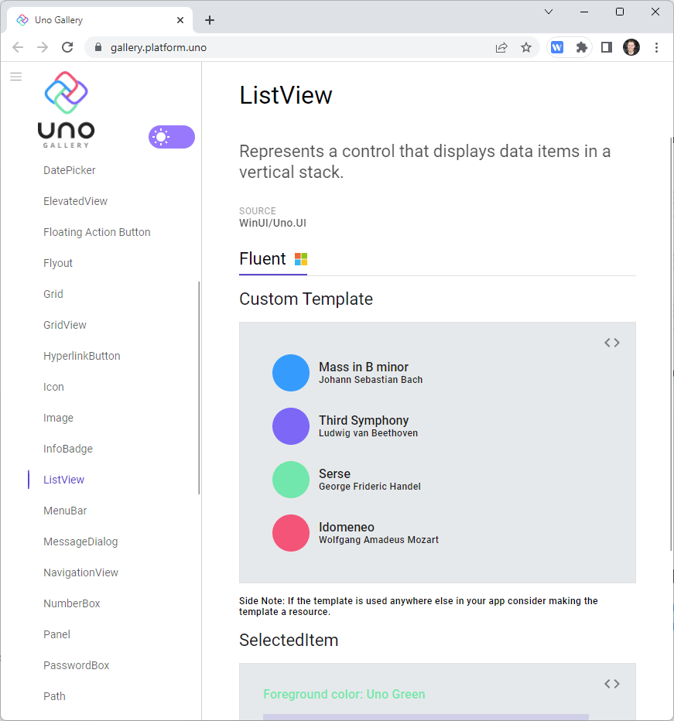
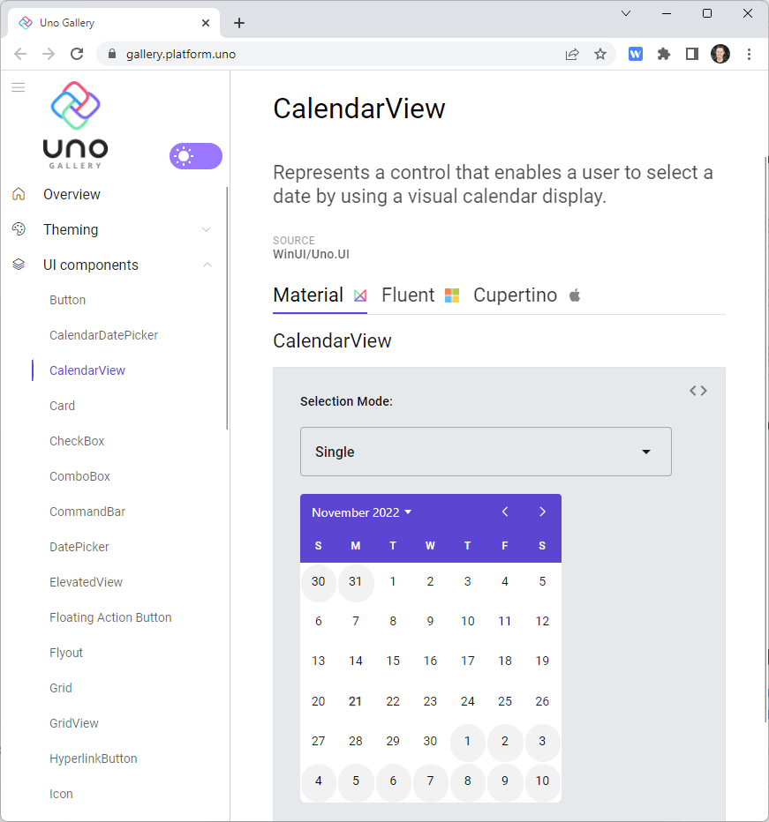
Uno Platform - Uno Gallery
Uno Gallery
A collection of ready-to-use Fluent and Material code snippets to help speed up your multi-platform development

Slide 22
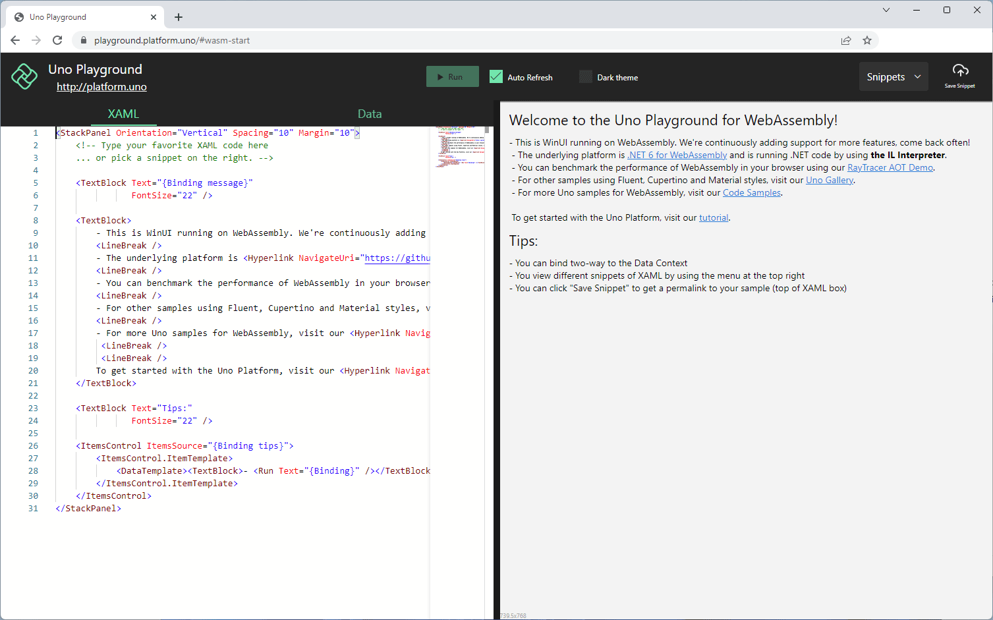
Uno Platform - Uno Playground
Write XAML live in the browser. Edit premade snippets or try your own code!

Slide 23
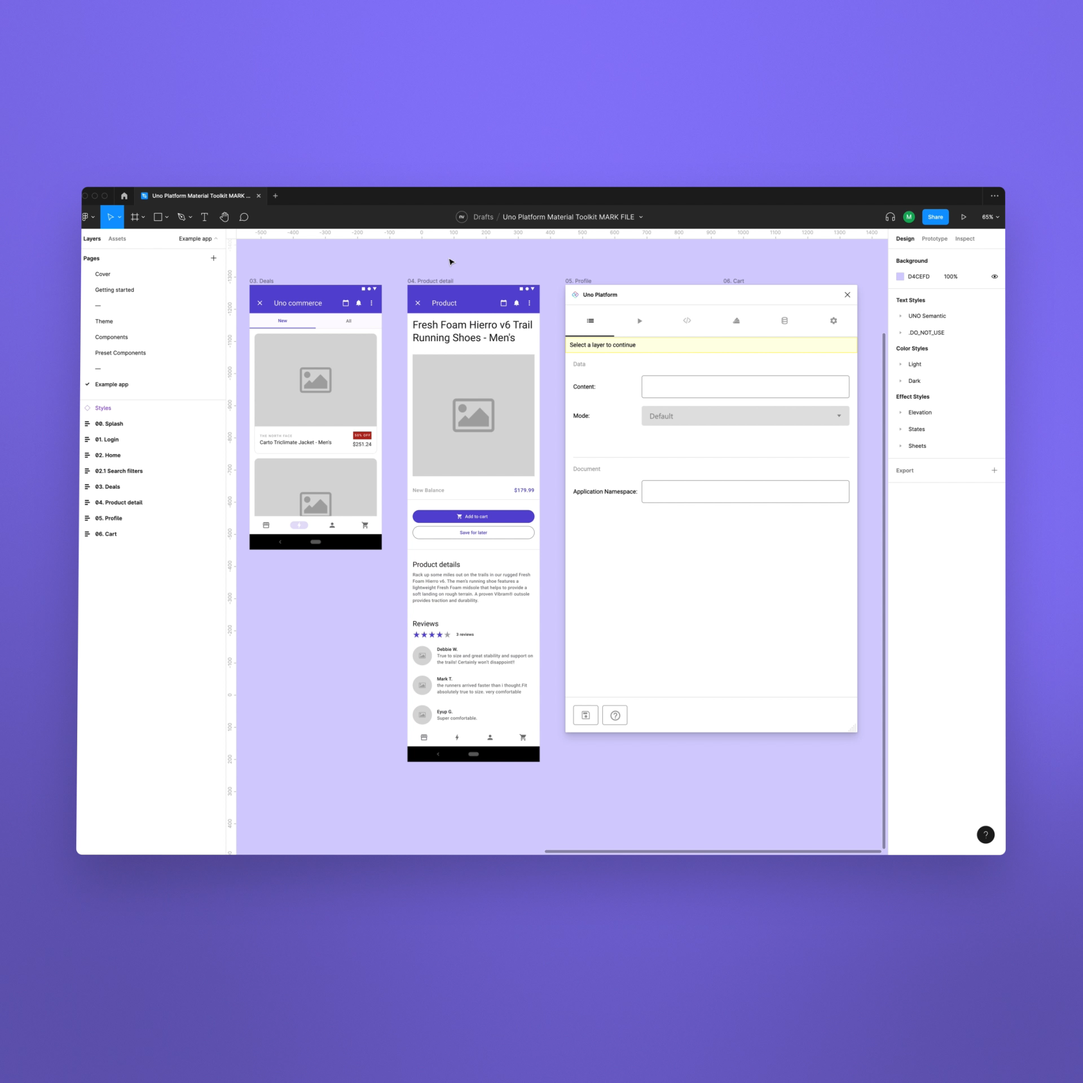
Uno Platform for Figma
Figma plugin for pixel-perfect XAML export for Uno Platform apps.
Copy from or to Visual Studio
Time Saving
Great for designers

Slide 24
Uno Platform
Uno Platform - https://platform.uno/
Uno Platform Gallery - https://gallery.platform.uno/
Uno Platform Playground - https://playground.platform.uno/
Uno Platform for Figma - https://platform.uno/unofigma/
GitHub - https://github.com/unoplatform
Video from .NET Conf: Building Windows apps with WinUI 3 and .NET – Nick Randolph https://youtube.com/watch?v=sYBCFTRmHOA

Slide 25

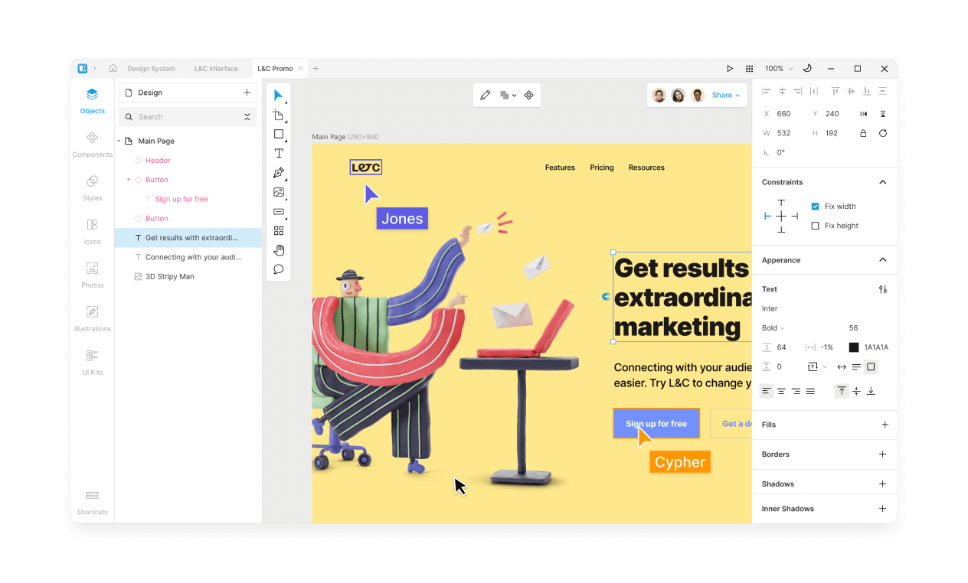

Avalonia UI
Create Multi-Platform Apps with .NET XAML and C#
Pixel Perfect on every platform
Drawn UI – Rendering with Skia (Direct2D on Windows also supported)
No dependencies on other UI toolkits No Xamarin.Forms or MAUI
Run on low powered embedded devices

Slide 26
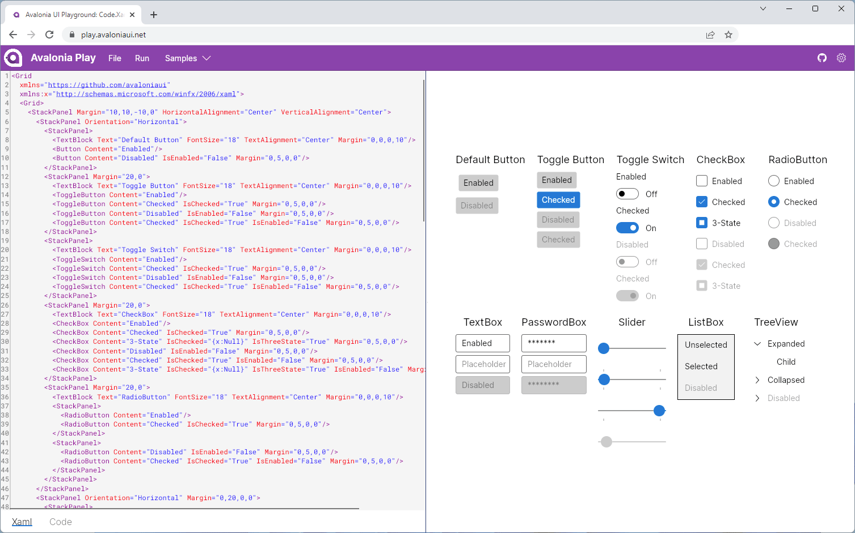
Avalonia UI - Avalonia Play
Code.Xaml.Live

Slide 27
Avalonia UI
Avalonia UI - https://avaloniaui.net/
Avalonia UI Playground - https://play.avaloniaui.net/
GitHub - https://github.com/AvaloniaUI/Avalonia
Video from .NET Conf: OSS Spotlight - Build amazing cross-platform UI for .NET with Avalonia UI! – Mike James https://youtube.com/watch?v=qcZSr2ejH5I

Slide 28


Thank you
Slides available on GitHub at https://github.com/mikeirvingweb/dotnetconf22-windows
- All links and video references in the README.md file
For more info, find / contact me at:
Twitter - https://twitter.com/mikeirvingweb
LinkedIn - https://www.linkedin.com/in/mikeirving
GitHub - https://github.com/mikeirvingweb
Stack Overflow - https://stackoverflow.com/users/482901/mike-irving
Website & Blog - https://www.mike-irving.co.uk/

Slide 29
Recap

